Slide 1
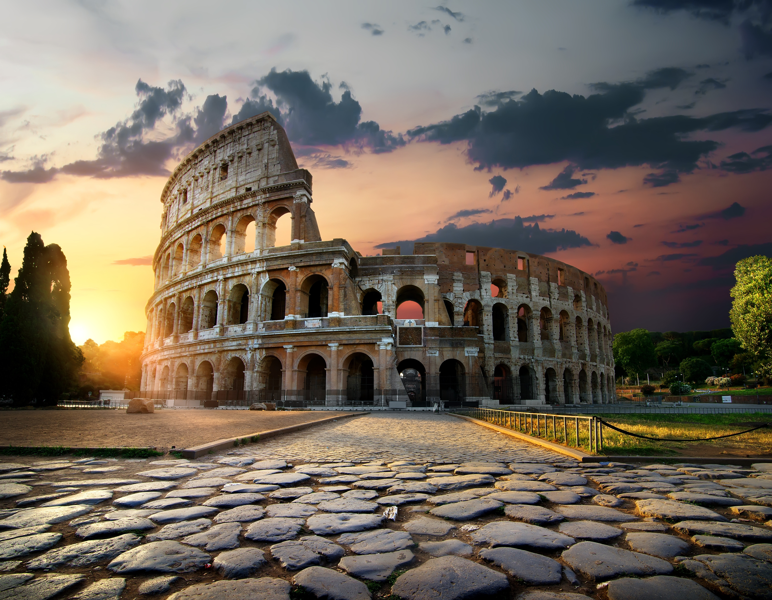



735 BC to AD 476
Chapter 4
ANCIENT ROME
ancient rome
Strand Three: The History of Europe and the Wider World
@MsDoorley

Slide 2
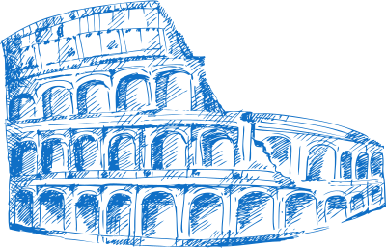

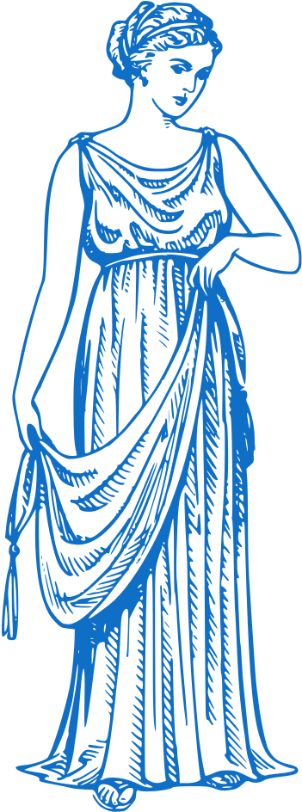

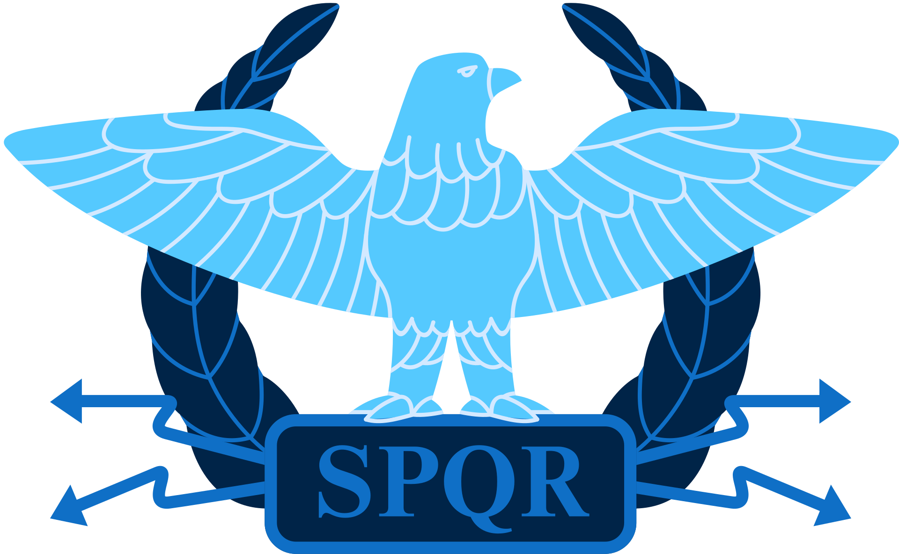
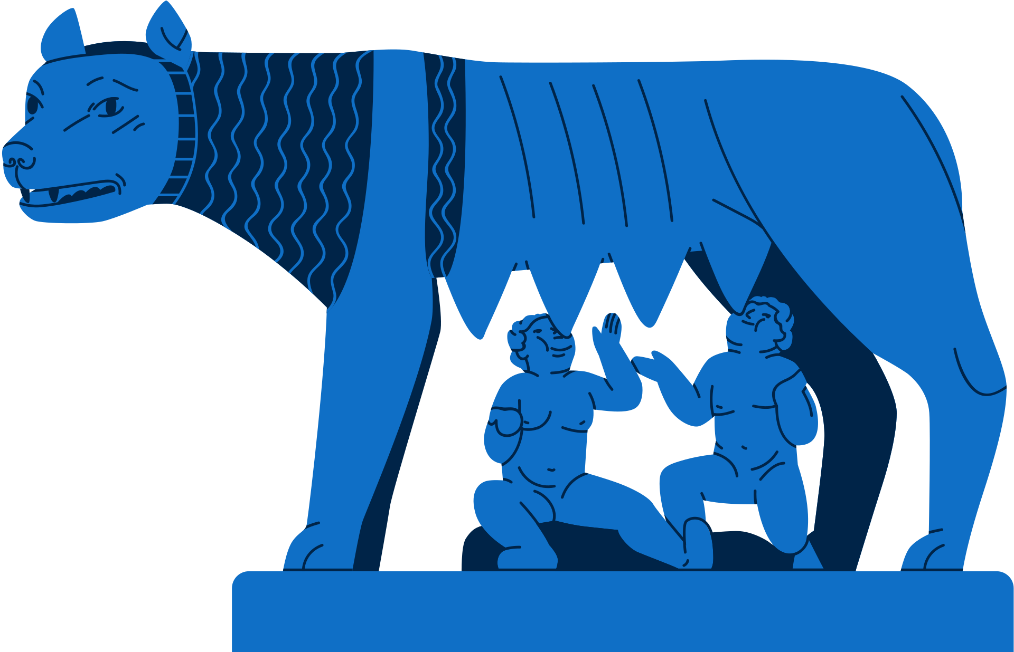

Chapter 4
ANCIENT ROME
3.1 INVESTIGATE the lives of people in one ancient or medieval civilisation of their choosing, explaining how the actions and/or achievements of that civilisation contributed to the history of Europe and/or the wider world
The Roman Republic is created.
Augustus becomes the first Roman Emperor
Emperor Constantine converts to Christianity on his deathbed.
735 BC
509 BC
44 BC
27 BC
AD 79
AD 312
AD 476
Strand Three: The History of Europe and the Wider World
Chapter One: The Historian
The City of Rome was founded by twin brothers, Romulus and Remus.
Assassination of Julius Caesar, the dictator of the Roman Republic on the Ides of March
The eruption of Mount Vesuvius buried the town of Pompeii and Herculaneum.
The Fall of the Western Roman Empire.

Slide 3


Learning Outcomes
3.1 INVESTIGATE the lives of people in one ancient or medieval civilisation
3.14 EXPLAIN how the actions and/or achievements of that civilisation contributed to the history of Europe and/or the wider world.
1.6 DEBATE the usefulness and limitations of different types of primary and secondary sources of historical evidence, such as written, visual, aural, oral and tactile evidence; and APPRECIATE the contribution of archaeology and new technology to historical enquiry
1.7 DEVELOP historical judgements based on evidence about personalities, issues and events in the past, showing awareness of historical significance
Strand Three: The History of Europe and the Wider World
Chapter Four: Ancient Rome
@MsDoorley

Slide 4
Introduction
Rome was one of the greatest powers in the ancient world. The city is said to have founded in 753 BC by Romulus and Remus, the twin sons of the god Mars. It grew from a collection of small villages on the river Tiber in Italy to control an empire that included Italy, Spain, France, North Africa, Greece, the Middle East, most of Britain and parts of Germany.
Initially ruled by kings, Rome became a republic in 509 BC, where the wealthy elite ruled the city through the Senate. The republic collapsed in 31 BC and was replaced by the empire, under the first emperor, Augustus. The Roman Empire eventually controlled all of the Mediterranean and much of Western Europe. It lasted until AD 476. The Ancient Romans have had a huge and enduring influence on the world we live in today.
Strand Three: The History of Europe and the Wider World
Chapter Four: Ancient Rome
@MsDoorley

Slide 5
735 BC to AD 476
Chapter 4
4.1: SOURCES ON ANCIENT ROME
4.1: Sources on Ancient Rome
Strand Three: The History of Europe and the Wider World
@MsDoorley

Slide 6
How do we know about the Romans?
Even though the Roman Empire ended over 1,500 years ago, we know a lot about it because the Romans left so much evidence behind them. There are written sources from Roman writers such as Caesar, Pliny and Virgil, who wrote about the history of Rome.
The physical remains of Roman life can also be seen all over Europe, North Africa and the Middle East; the ruins of many buildings and many everyday artefacts (such as coins, weapons, tools and toys) have survived.
Most important are the remains of the Roman town of Pompeii, which was buried by the eruption of Mount Vesuvius in AD 79. The volcanic ash preserved the town just as it was, and archaeologists have been excavating it since 1748.
Strand Three: The History of Europe and the Wider World
Chapter Four: Ancient Rome
@MsDoorley

Slide 7
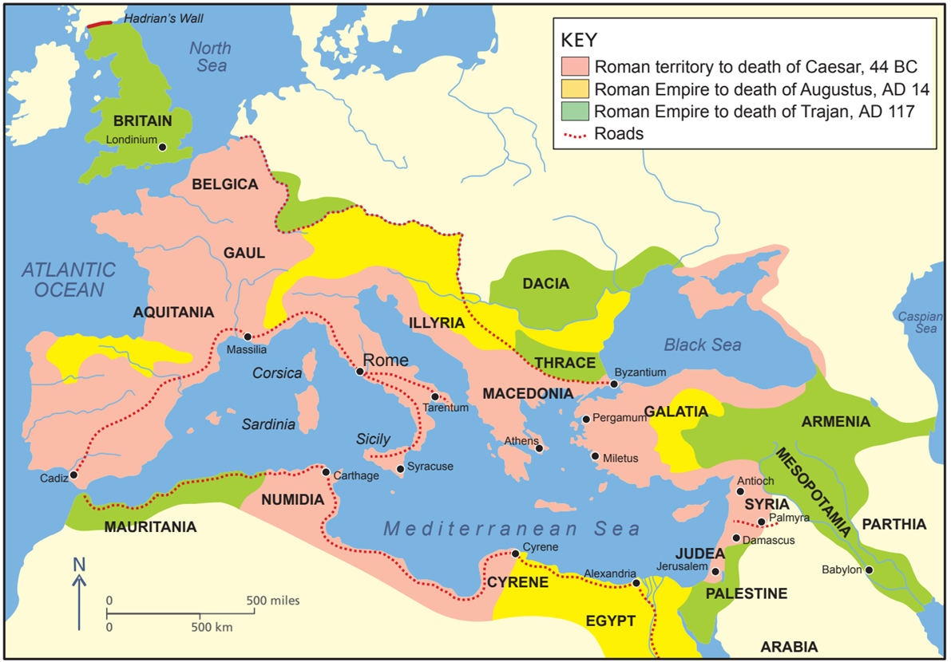
Checkpoint (Pg. 23, Artefact 2nd Edition)
  Name three sources of evidence on Ancient Rome.
  Who did the Romans believe founded their city?
  Look at the map and name five modern countries that were once ruled by Rome.
  What is a republic?
  For how long was Rome a republic?
Strand Three: The History of Europe and the Wider World
Chapter Four: Ancient Rome
@MsDoorley

Slide 8
Checkpoint (Pg. 23, Artefact 2nd Edition)
  Any three of: written sources from Roman writers such as Caesar, Pliny, Virgil; physical remains of Roman life all over Europe, North Africa and the Middle East; the ruins of many buildings; everyday artefacts such as coins, weapons, tools and toys; the ruins of Pompeii.
  Romulus and Remus, the twin sons of the god Mars.
  Any five of: Italy, France; Spain; Portugal; Algeria; Morocco; Tunisia; Libya; Egypt; Israel; Jordan; Syria; Lebanon; Iraq; Türkiye; Greece; Cyprus; Bulgaria; Romania; Serbia, Croatia; Slovenia; Macedonia; Albania; Kosovo; Hungary; Austria; Germany; Switzerland; Belgium; Netherlands; England; Wales.
  Republic: where the wealthy elite ruled the city through the senate.
  478 years (509 BC to 31 BC).
Strand Three: The History of Europe and the Wider World
Chapter Four: Ancient Rome
@MsDoorley

Slide 9
Roman Towns
As their empire expanded into Europe, the Romans controlled each local area from towns they founded. Romans lived here with the native peoples, many of whom became citizens (people who had rights under Roman law) of the empire.
Most Roman towns shared similar features:
  walls for defence.
  paved streets laid out in a grid system (similar to what we use today)
  a forum; a large town square, was the centre of business, political activity and religious worship
  temples for worshop
  aqueducts to bring fresh water to the town
  theatres for plays and preformances
  monuments or trimphal arches to commemorate Rome's history
  public baths, where people bathed, exercised and met friends
  public toilets and drinking fountains
  an amphitheatre, where gladitorial games were held
Strand Three: The History of Europe and the Wider World
Chapter Four: Ancient Rome
@MsDoorley

Slide 10
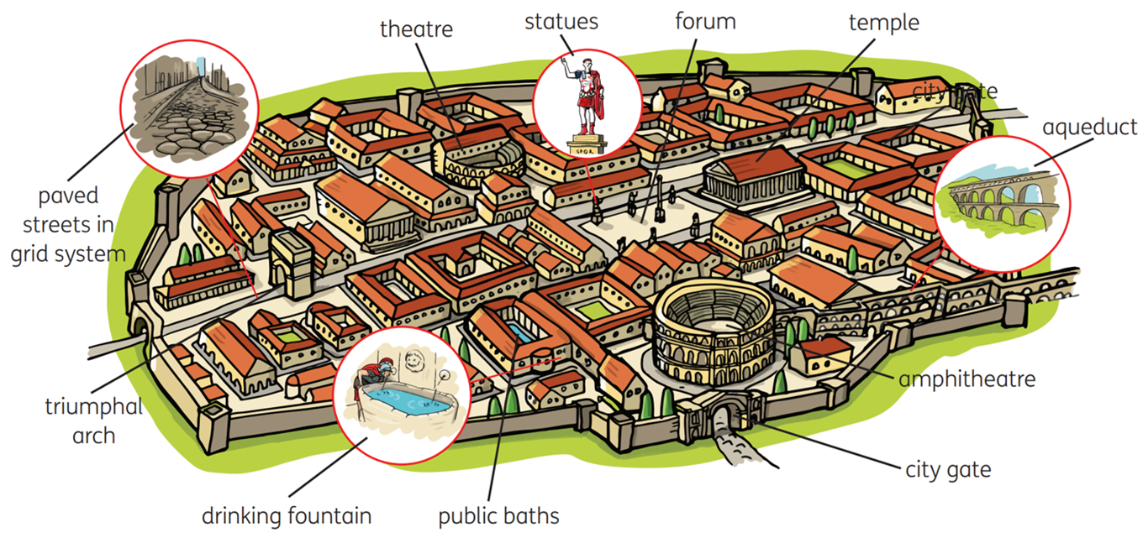
Roman Towns
Strand Three: The History of Europe and the Wider World
Chapter Four: Ancient Rome
Diagram taken from Artefact, 2nd Edition by Eimear Jenkinson and Gregg O'Neill (educate.ie)
@MsDoorley

Slide 11
Checkpoint (Pg. 24, Artefact 2nd Edition)
  What system was used to lay our Roman towns?
  What was the role of the forum in a Roman town?
  Name three buildings that were used for leisure activities.
Strand Three: The History of Europe and the Wider World
Chapter Four: Ancient Rome
@MsDoorley

Slide 12
735 BC to AD 476
Chapter 4
4.2: THE ROMAN ARMY
4.2: the roman army
The army was central to Roman life – it allowed Rome to conquer and keep control over its vast empire.
Ambitious generals could also use the army to gain political power.
For ordinary Romans, being a soldier was a really good profession to have.
Individual Roman foot soldiers were called legionaries who made up a legion.
Strand Three: The History of Europe and the Wider World
@MsDoorley

Slide 13
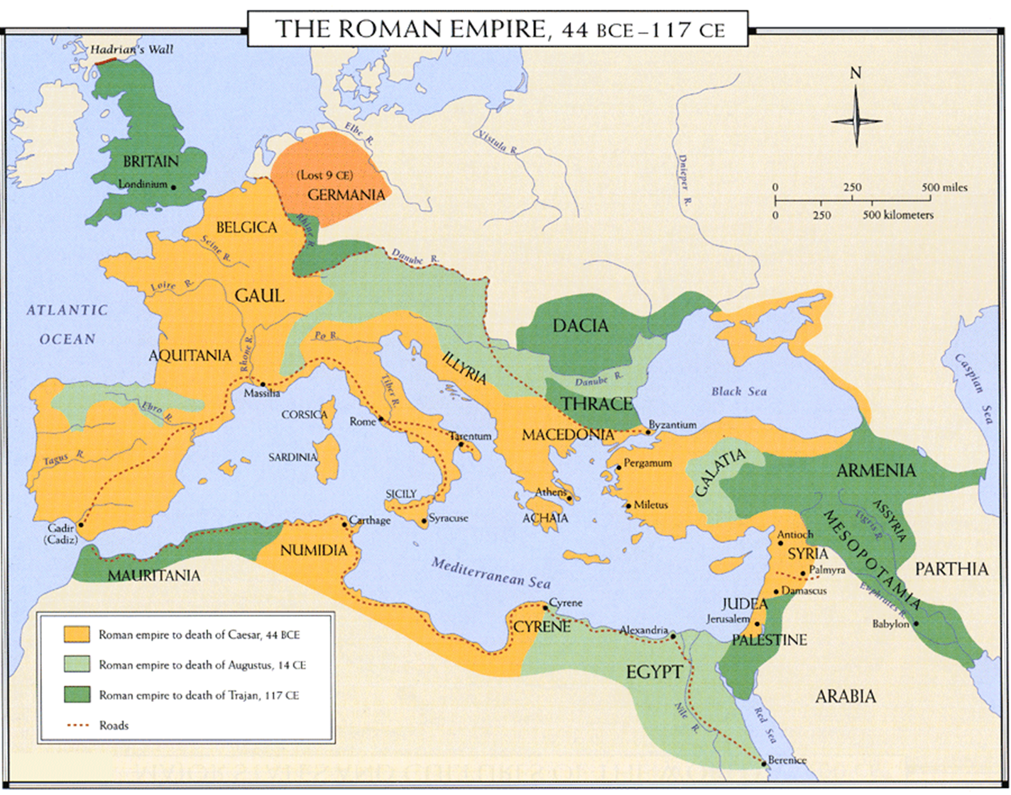
Strand Three: The History of Europe and the Wider World
Chapter Four: Ancient Rome
@MsDoorley

Slide 14








The Roman Army
8 Men = 1 Tent Party
The eight men shared a tent (or two rooms in a barracks) and carried a complete set of equipment.
10 Tent Parties =
1 Century (80 Men)
Strand Three: The History of Europe and the Wider World
Chapter Four: Ancient Rome
6 Centuries =
1 Cohort (480 Men)
A LEGION HAD 10 COHORTS
The first cohort was twice the size of the others (960 men) and also had 120 horsemen.
TOTAL FIGHTING STRENGTH = 5,400 MEN
Another 400 engineers, doctors, cooks, officials and animal handlers travelled with the legion.
@MsDoorley

Slide 15
Life of a Roman Soldier
A soldier enlisted at the age of 20 and served for 25 years. At the end of his service, he received a final payment and a plot of land to farm somewhere in the empire. This allowed Rome to settle loyal soldiers throughout the empire.
Soldiers were trained to fight with various weapons, on foot and on horseback. They trained with wooden weapons twice the weight of ordinary weapons and were made march up to 30km every day while carrying over 35kg of weapons and equipment. At their destination, they had to build camp.
Soldiers practiced all the time to ensure they were always battle-ready.
When not on campaign, soldiers were often employed to build public works such as: Aqueducts, Bridges, Defensive walls and Roads.
Strand Three: The History of Europe and the Wider World
Chapter Four: Ancient Rome
@MsDoorley

Slide 16
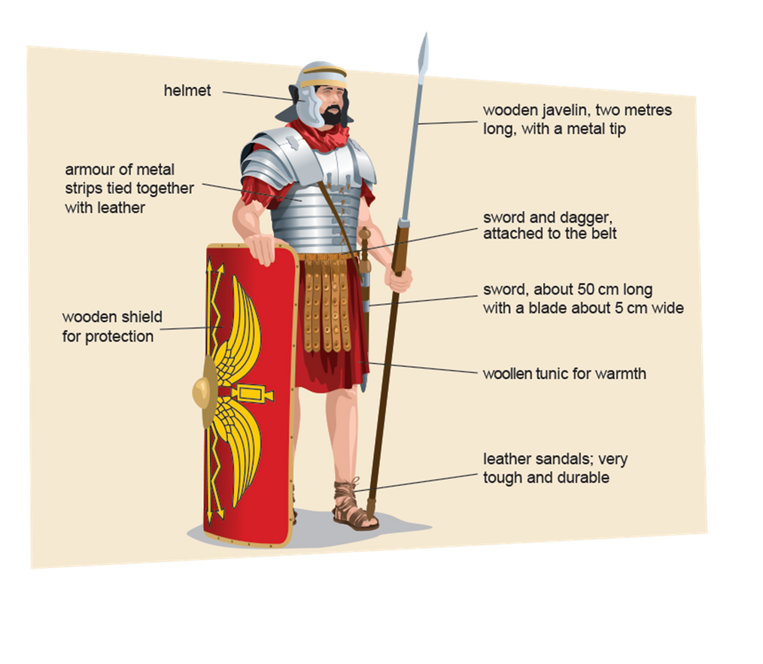
Life of a Roman Soldier
Soldiers could serve in:
  The Infantry – foot soldiers
  The Cavalry – soldiers on horseback
  The Artillery – used projectile weapons
Roman engineers developed catapults, ballistas and other machines of war to throw boulders, urns of burning pitch or huge crossbow bolts over great distances at an enemy army or city.
A legionnaire was a foot soldier who was also a Roman citizen.
Auxiliaries were people who were conquered by the Romans and recruited into the Roman army. They were also archers, slingers and cavalry.
Strand Three: The History of Europe and the Wider World
Chapter Four: Ancient Rome
@MsDoorley

Slide 17
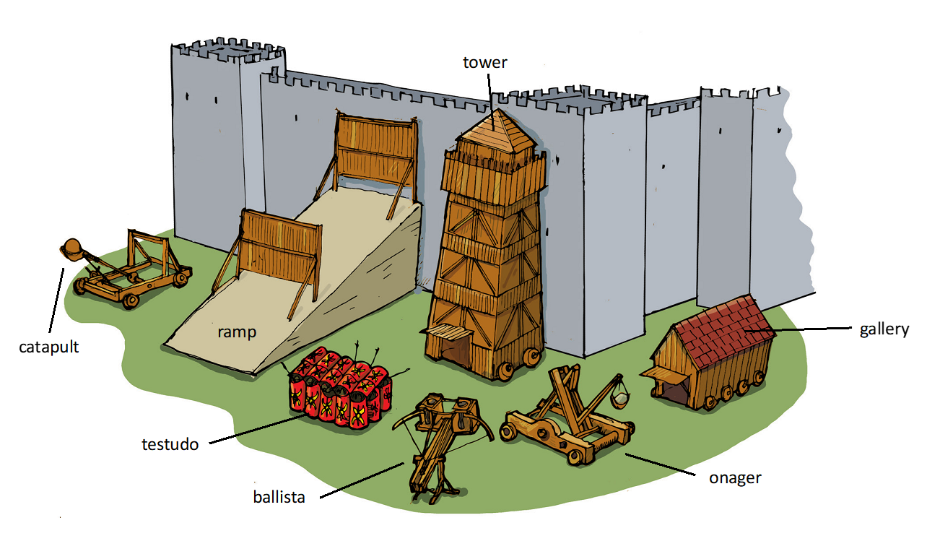
Strand Three: The History of Europe and the Wider World
Chapter Four: Ancient Rome
@MsDoorley

Slide 18
Checkpoint (Pg. 59, Artefact 1st Edition)
  Why did Rome need a large professional army?
  For how long did a soldier serve?
  What weapons did a Roman soldier use?
  Why do you think they trained with weapons twice the weight of normal weapons?
  Describe the structure of a legion.
  Write a paragraph (5-6 lines) on the daily life of a soldier.
Strand Three: The History of Europe and the Wider World
Chapter Four: Ancient Rome
@MsDoorley

Slide 19
Checkpoint (Pg. 59, Artefact 1st Edition)
  To conquer, control and defend their empire.
  A soldier served for 25 years.
  Sword, shield, helmet, spear, body armour, leg armour.
  So that they would become strong and would not tire in long battles wielding the real, lighter weapon.
  Eight men made up a tent party; 10 tent parties made up a century; 10 centuries made up a cohort; 10 cohorts made up a legion.
  Soldiers were trained to fight with various weapons, on foot and on horseback. They trained with wooden weapons twice the weight of ordinary weapons and were made march up to 30km every day while carrying over 35kg of weapons and equipment. At their destination, they had to build camp. Soldiers practiced all the time to ensure they were always battle-ready. When not on campaign, soldiers were often employed to build public works such as: Aqueducts, Bridges, Defensive walls and Roads.
Strand Three: The History of Europe and the Wider World
Chapter Four: Ancient Rome
@MsDoorley

Slide 20
735 BC to AD 476
Chapter 4
4.2: DAILY LIFE IN ROME
4.2: Daily Life in Rome
Strand Three: The History of Europe and the Wider World
@MsDoorley

Slide 21
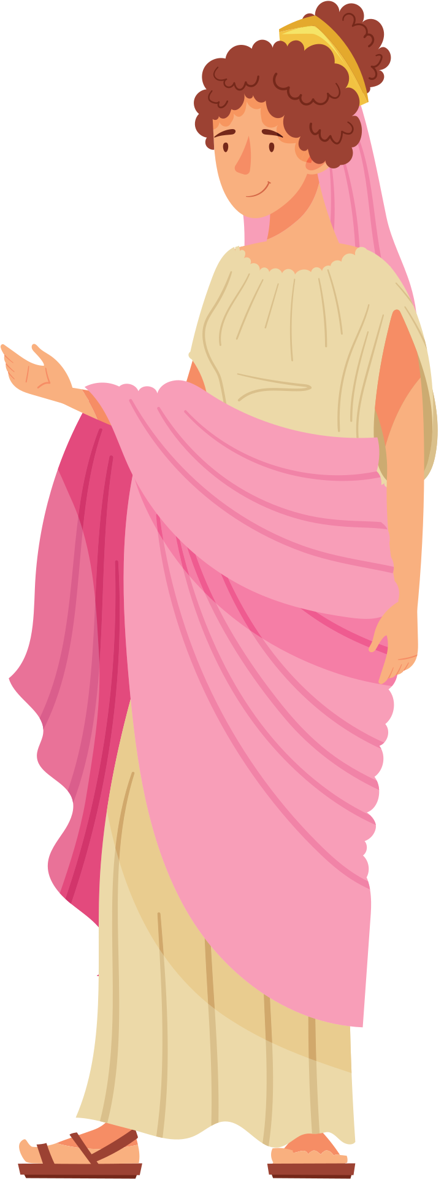
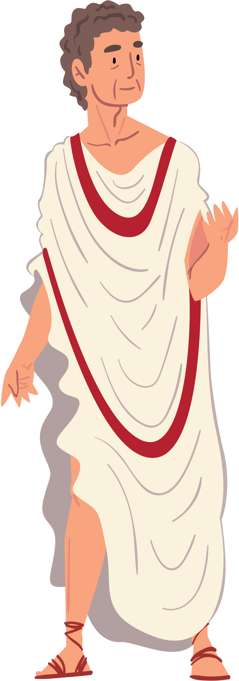
The people of Ancient Rome: Patricians
The patricians were the wealthy noble families who ruled Rome. They had huge states and hundreds of slaves. They controlled the Roman government and army.
Patricians served in the Senate, were military generals or governors of Rome's provinces.
Men wore a toga (a long white robe draped over the shoulder and down to the feet), and women wore a stola (a long dress).
A patrician house in a town was called a domus while one in the countryside was called a villa.
Strand Three: The History of Europe and the Wider World
Chapter Four: Ancient Rome
@MsDoorley

Slide 22
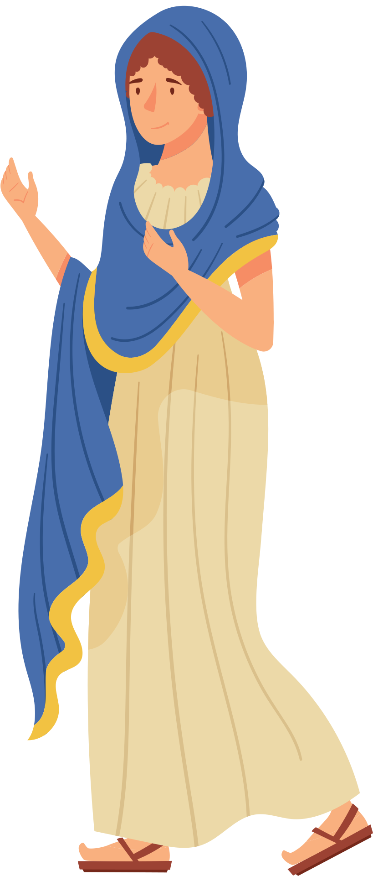
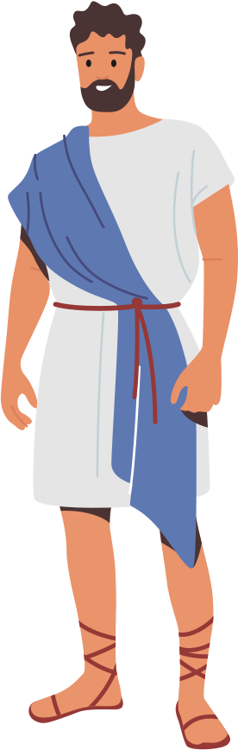
The people of Ancient Rome: Plebians
The plebeians were the poor, who made up the vast majority of the population. They farmed, worked in trades and served in the army.
They were given dole - a payment of free grain - so that they would support the rule of the patricians.
Plebeian men wore a tunic to their knees and women wore a plain stola.
Some plebeians became quite wealthy through trade and business (equites). They had money but no political power.
Most plebeians lived in apartment blocks called insulae.
Strand Three: The History of Europe and the Wider World
Chapter Four: Ancient Rome
@MsDoorley

Slide 23
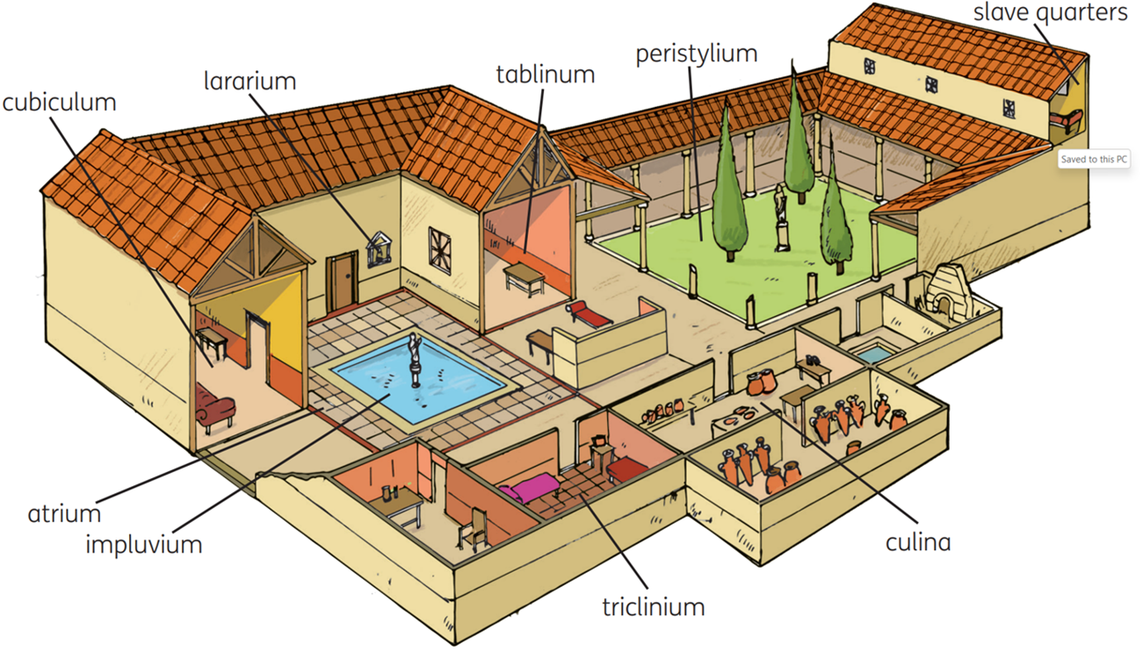
A Patrician Domus
Strand Three: The History of Europe and the Wider World
Chapter Four: Ancient Rome
Diagram taken from Artefact, 2nd Edition by Eimear Jenkinson and Gregg O'Neill (educate.ie)
@MsDoorley

Slide 24
A Patrician Domus
The patrician home had a central courtyard called the atrium where guests were met. This had a pool called an impluvium to collect rain water and a shrine to the family gods (the lararium). Other rooms led off this: the bedrooms (cubiculum), the kitchen (culina), the study (tablinum) and the dining room (triclinium). Upstairs were the slave quarters and outside was a walled garden (peristylium). The walls were decorated with paintings and the floors with mosaics, pictures from small pieces of stone, glass or tile. The houses of the richest patricians also had running water and underfloor heating. A domus had small windows and was usually quite dark inside, with light provided by the atrium and oil lamps.
Strand Three: The History of Europe and the Wider World
Chapter Four: Ancient Rome
@MsDoorley

Slide 25
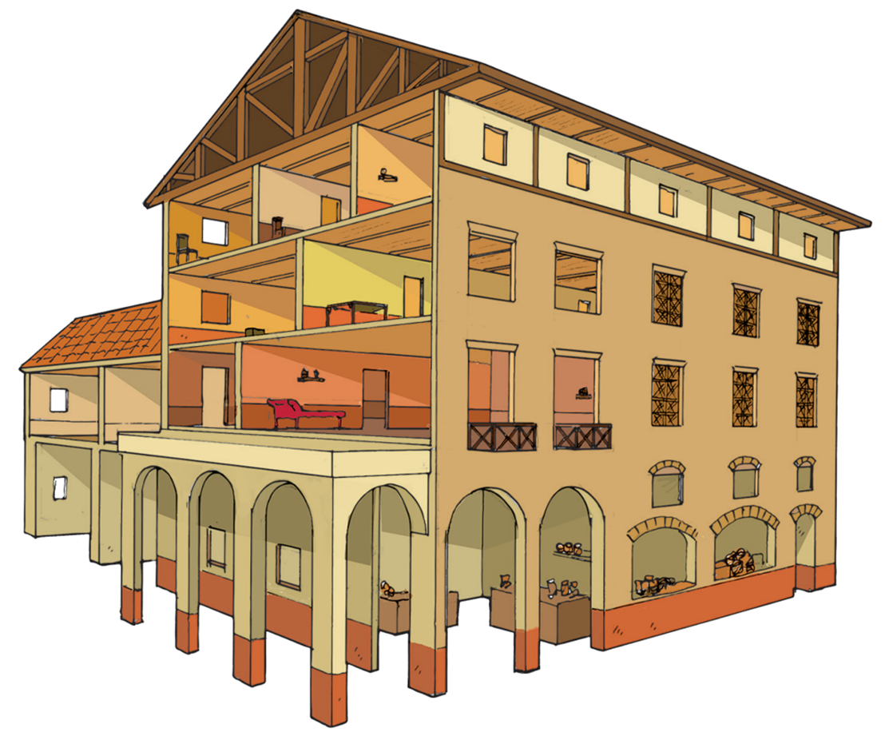
A Plebeian Insulae
In Rome, the plebeian insulae were usually five storeys high. The ground floor had shops or workshops that opened onto the streets. The floors above them were apartments. The higher you went, the smaller the apartments became. Those at the top were made from wood (constant threat of fire) and often families had to share a single room. The poorest Romans lived at the top. There was no running water and rubbish was thrown out the windows.
Strand Three: The History of Europe and the Wider World
Chapter Four: Ancient Rome
Diagram taken from Artefact, 2nd Edition by Eimear Jenkinson and Gregg O'Neill (educate.ie)
@MsDoorley

Slide 26
Checkpoint (Pg. 26, Artefact 2nd Edition)
  Explain the following terms: patrician, plebeian, mosaics.
  What are the most important differences between a domus and an insulae?
  Describe a domus.
  Describe an insulae.
  Why was there a high risk of fire in the insulae?
Strand Three: The History of Europe and the Wider World
Chapter Four: Ancient Rome
@MsDoorley

Slide 27
Checkpoint (Pg. 26, Artefact 2nd Edition)
    Patrician: wealthy noble families who ruled Rome
    Plebeian: the poor, who made up the vast majority of the population. They farmed, worked in trades and served in the army
    Mosaics: pictures made from small pieces of stone, glass or tile.
  A domus was large and housed a single family and slaves, while an insulae was a block of apartments that housed many families; a domus was made of stone, an insulae’s upper floors were made of wood; a domus had a garden, an insulae apartment did not.
  Domus: a large detached house, with a central courtyard called an atrium. It had a pool called an impluvium to collect rain water and a shrine to the family gods (the lararium). The domus’ other rooms included bedrooms (cubiculum), the kitchen (culina), the study (tablinum) and the dining-room (triclinium). Upstairs were the slave quarters and outside was a walled garden (peristylium). The walls were decorated with paintings and the floor with mosaics.
  Insulae: apartment block, usually five storeys high. The ground floor had shops or workshops. Above them were apartments. The higher you went, the smaller the apartments became. Those at the top were made of wood and often entire families had to share a single room. The poorest Romans lived on these higher floors. There was no running water and rubbish was thrown into the streets below.
  The upper floors were made of wood and the residents used stoves for cooking and heating.
Strand Three: The History of Europe and the Wider World
Chapter Four: Ancient Rome
@MsDoorley

Slide 28
Slaves
Slaves were an everyday feature of Ancient Roman life. By law, slaves were the property of their owners. In Rome itself, there were over 300,000 slaves from different sources:
  Prisoners of war.
  The children of slaves were automatically slaves.
  People captured by pirates or bandits.
  Parents in debt sometimes sold their own children into slavery to pay off their debts.
Thousands of slaves worked on public building projects such as the aqueducts or arches. Most patricians owned dozens of slaves who did the cooking, cleaning and other manual labour. Others worked on farms or in mines where they were often worked to death. Slaves were often branded by their master’s initials with a hot iron in case they ran away. These cruel conditions led to several famous slave rebellions. The most famous was led by gladiator Spartacus in 71 BC.
Well educated slaves, often Greeks, were highly valued and treated well. They were usually employed as teachers, secretaries and doctors. Unlike their uneducated companions, these educated slaves were sometimes given freedom after many years of service to their master (manumission)
Strand Three: The History of Europe and the Wider World
Chapter Four: Ancient Rome
@MsDoorley

Slide 29
What ancient civilisation have we studied which did allow women to take part in public life?
Women in Ancient Rome
Women, both patrician and plebeian, were citizens but unable to vote or take part in public life.
Roman girls were usually married by the age of 14/15. Marriages were to benefit the families involved and the girl had little to no say in the man her father chose. However, divorce was legal. The wedding ceremony (conferratio) was held at the bride’s house. A wife was expected to: run her husband’s home, make his clothes, supervise slaves, bear a son and oversee the rearing of their children.
Plebeian women would also work outside the home, for example in the market or their husband's business, or as a midwife or as a weaver. Roman women did have some rights under the law. For example, a woman's property was kept separate from her husband's and could be taken with her if they divorced.
Many women died in childbirth so men often married several times. A girl could easily end up marrying a man her father’s age.
Strand Three: The History of Europe and the Wider World
Chapter Four: Ancient Rome
@MsDoorley

Slide 30
Education
Plebeian children received a basic education at home and then began working with their parents.
Patrician children, on the other hand, had four stages to their education.
  Children were educated by a tutor (often a slave) or their parents at home until the age of 7.
  From ages 7 to 12, they went to school (ludus) where they learned reading writing and arithmetic (maths).
  At 12, boys could go on to a grammaticus to learn Greek and Roman literature, history, arithmetic and geometry. Girls finished school at 12 and were taught embroidery, flower arranging and how to run a household by their mother.
  At 16, a patrician boy was taught oratory (the art of public speaking) by a rhetor to prepare him for a career in public life. Further study for boys was done abroad in Greece.
Discipline was very strict in Roman schools and students would be beaten for making mistakes. They wrote with a pointed wooden stylus on a wax tablet, which could later be melted and reused. They used an abacus to learn arithmetic. They attended from dawn till noon, because the mid-day heat was too much.
Strand Three: The History of Europe and the Wider World
Chapter Four: Ancient Rome
@MsDoorley

Slide 31
Checkpoint (Pg. 28, Artefact 2nd Edition)
  What were the Romans' main sources of slaves?
  What sorts of work did slaves do?
  What did Roman children learn (a) at a ludus; (b) at a grammaticus and (c) with a rhetor?
  How was education different for boys and girls?
  Why were marriages arranged in Ancient Rome?
  Explain the following term: manumission.
Strand Three: The History of Europe and the Wider World
Chapter Four: Ancient Rome
@MsDoorley

Slide 32
Checkpoint (Pg. 28, Artefact 2nd Edition)
  Prisoners of war; children of slaves; people captured by pirates or bandits while travelling; parents in debt sold their own children into slavery.
  They worked on Rome’s public building projects such as aqueducts; in patricians’ homes cooking, cleaning and other manual labour; on farms or in mines; educated slaves were teachers, secretaries and doctors.
    Ludus: reading, writing and arithmetic;
    Grammaticus (boys only): history, grammar, geometry, Roman and Greek literature;
    Rhetor: oratory(the art of public speaking)(boys only).
  From the age of 12, girls were kept at home and taught by their mother show to spin, weave and run a household. Only boys were educated from the age of 12.
  For the benefit of the families involved.
  Manumission: when slaves were given their freedom after many years of service to their master.
Strand Three: The History of Europe and the Wider World
Chapter Four: Ancient Rome
@MsDoorley

Slide 33
735 BC to AD 476
Chapter 4
4.3: ENTERTAINMENT IN ROME
4.3: Entertainment in Rome
Public entertainment were very important in Rome.
Along with the grain dole, public entertainment was the main way that ambitious politicians and emperors ensured they had the support of the people.
Strand Three: The History of Europe and the Wider World
@MsDoorley

Slide 34
The Public Baths
Every Roman town had public baths. Bathing was very important to the Romans. Most homes did not have running water, so it was the easiest way to stay clean. The baths were also a social place where people met friends, did business and exchanged news. The largest baths in every town were free to use for citizens.
A typical visit to the baths would involve each of the three main rooms: the tepiadrium (the medium heat room); the caldarium (the hot room, much like a sauna); and the frigidarium (the cold water bath). Visitors rubbed oil into their skin, worked up a sweat in the caldarium and then used a wooden strigil to scrape their skin, removing dry skin and dirt along with the oil. There was also an exercise yard (the palaestra) and rooms where a massage or food was available. Most baths had separate areas for men and women, though smaller ones just had separate bathing times.
Strand Three: The History of Europe and the Wider World
Chapter Four: Ancient Rome
@MsDoorley

Slide 35
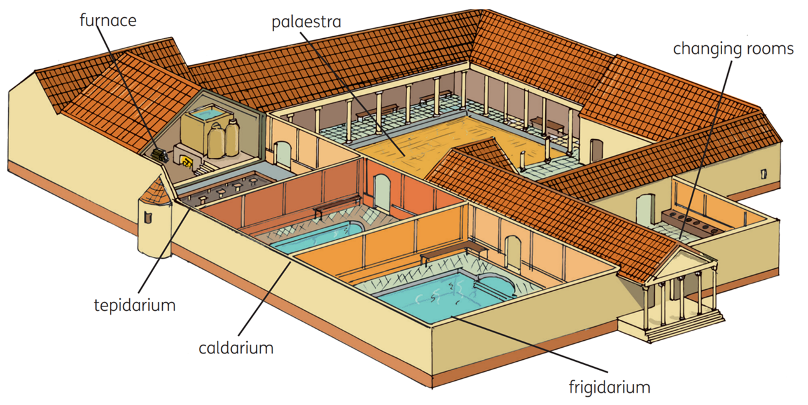
The Public Baths
Strand Three: The History of Europe and the Wider World
Chapter Four: Ancient Rome
Diagram taken from Artefact, 2nd Edition by Eimear Jenkinson and Gregg O'Neill (educate.ie)
@MsDoorley

Slide 36
Chariot Racing at the Circus Maximus
Rome's chariot racing arena, the Circus Maximus, was 500m long and could seat up to 250,000 people. There was no seating division based on social status or gender. Four teams (red, white, blue and green) would race in chariots pulled by teams of two, four or six horses. They raced around the track seven times at incredibly high speeds. It was a very dangerous sport and there were often crashes that killed men and horses. Gambling on the races was a popular activity.
Strand Three: The History of Europe and the Wider World
Chapter Four: Ancient Rome
@MsDoorley

Slide 37
Homework
Research 5 facts about the Circus Maximus and the Colosseum.
Strand Three: The History of Europe and the Wider World
Chapter Four: Ancient Rome
@MsDoorley

Slide 38
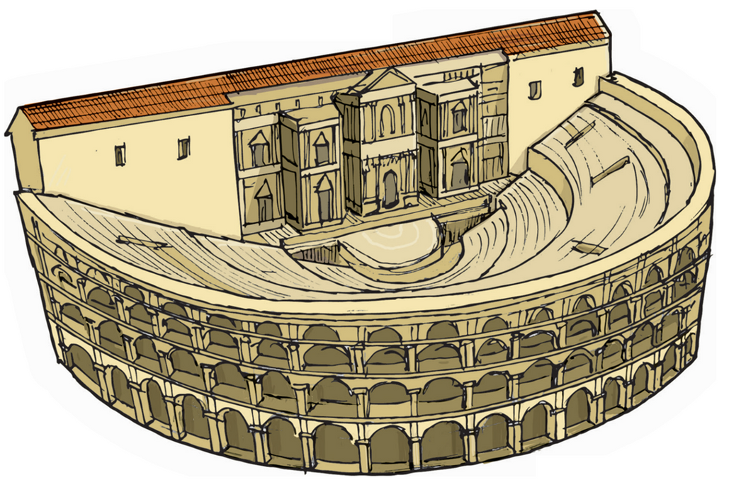
Roman Theatre
Most Roman towns had a theatre. These were large semi-circular buildings with stone seats for the audience, who were separated by gender and social status, with women and slaves seated at the back.
Tragedy (sad) and comedy (happy) were both very popular with the Romans, with subjects ranging from stories about the Gods and heroes to everyday life events. The actors were all male and wore masks while preforming.
Strand Three: The History of Europe and the Wider World
Chapter Four: Ancient Rome
Diagram taken from Artefact, 2nd Edition by Eimear Jenkinson and Gregg O'Neill (educate.ie)
@MsDoorley

Slide 39
Amphitheatres and Gladiators
The most popular entertainers were gladiators were mostly former soldiers who were captured in battle and sold as slaves; they fought in oval arenas called amphitheatres in nearly every major Roman city. The most famous amphitheatre was the Colosseum in Rome which could hold over 50,000 spectators in tiered seating. It even had a canopy to protect people from the sun.
Seating was strictly arranged by social status and arranged in four tiers: closest to the action was the male patricians. Then the male plebeians. Then male foreigners. At the back were the women and slaves.
Gladiators were often dressed in very different styles to match their fighting style. They were trained in special schools and were treated like modern sports stars by ordinary Romans. Each gladiator would be proficient in using one set of weapons. Examples of gladiators include:
  A retiarius would use a trident and net.
  A murmillo would use a soldier’s shield and a sword (gladius). They wore a fish shaped crest on a full-cover helmet.
  A thraxes would use a small, rectangular shield and a curved sword (thracian). They wore a griffin shaped crest on their full-cover helmet.
  An essedarius was a mounted gladiator who fought on chariots.
  A hoplomachus, meaning 'armed fighter' in Greek, would use a throwing spear, a short sword and a small, round shield. They wore a plumed helmet.
Strand Three: The History of Europe and the Wider World
Chapter Four: Ancient Rome
@MsDoorley

Slide 40
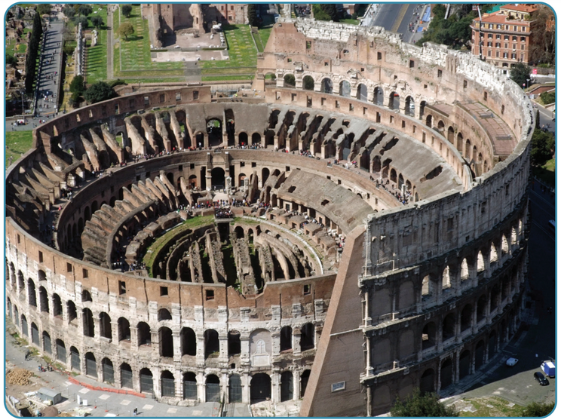
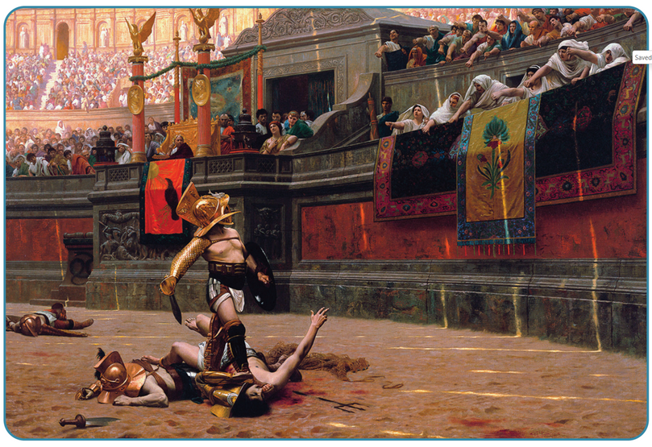
Amphitheatres and Gladiators
Gladiators rarely fought to the death because they were so expensive to buy, train and feed (Owners wanted a longer return on their investment). Instead, most fights ended when one of the fighters was too badly injured to continue.
Amphitheatres also featured:
  Fights between people and exotic wild animals (such as lions and tigers)
  The executions of criminals
  Myths acted out for the crowd.
The Colosseum in Rome could even be flooded for mock sea battles.
Strand Three: The History of Europe and the Wider World
Chapter Four: Ancient Rome
Photos taken from Artefact, 2nd Edition by Eimear Jenkinson and Gregg O'Neill (educate.ie)
@MsDoorley

Slide 41
Checkpoint (Pg. 31, Artefact 2nd Edition)
  Why was public entertainment so important in Rome?
  Why did people use public baths in Rome?
  Describe the Circus Maxiumus.
  Why was chariot racing so dangerous?
  Describe a Roman theatre.
  Why do you think actors wore masks in Roman plays?
  Describe the Colosseum in Rome.
  Where did most gladiators come from?
  Why was it rare for gladiators to fight to the death?
  Other than gladiatorial contests, what events were held in amphitheatres?
  How was life in a Roman town (a) similar and (b) different to our lives today?
Strand Three: The History of Europe and the Wider World
Chapter Four: Ancient Rome
@MsDoorley

Slide 42
Checkpoint (Pg. 31, Artefact 2nd Edition)
  It was a good way for Roman leaders to ensure they kept the support of the public.
  For hygiene (most homes did not have running water); to meet their friends; to do business; to exchange news.
  3.The Circus Maximus was a large oval-shaped stadium, 500 m long, with seating along the sides for over 250,000 people. The chariots had to race around the track seven times.
  There were many crashes, and the drivers and horses were often killed.
  A Roman theatre was a large semi circular building with stone seats for the audience facing the stage area where actors performed.
  Toallow them to play various different people or to represent gods, monsters; to allow men to play women.
  It was an oval-shaped amphitheatre that could hold over 50,000 spectators in tiered seating and even had a canopy to protect people from the sun. The seats were strictly arranged on the basis of social status. The seats closest to the action were reserved for male patricians, the seats behind them for male plebeians, then male foreigners, then at the very back were women and slaves.
  Most gladiators were former soldiers who were captured in battle and sold as slaves.
  They were so expensive to buy, train and feed that their owners wanted a longer return on their investment. If they died in the arena, that investment would be wasted.
  Fights between people and exotic wild animals (lions),executions of criminals, myths acted out for the crowd.
  Students’ own answers.
Strand Three: The History of Europe and the Wider World
Chapter Four: Ancient Rome
@MsDoorley

Slide 43
735 BC to AD 476
Chapter 4
4.4: RELIGION IN ROME
4.4: religion in rome
Strand Three: The History of Europe and the Wider World
@MsDoorley

Slide 44
Roman Gods and Goddesses
Religion was very important to the Ancient Romans. They were polytheists which means they believed in many gods (just like the Celts!). Their main Gods were Jupiter, Mars, Neptune and Minerva. Most of the Roman gods and goddesses had come from Greek beliefs; their names were often different but their myths, functions and personalities stayed the same.
Roman Name | Greek Name | God of...
Jupiter | Zeus | King of the Gods Sky, Thunder and Lightning
Neptune | Poseidon | The Sea
Pluto | Hades | The Underworld
Apollo | Apollo | The Sun, Music, Prophecy and Healing
Vulcan | Hephaestus | Metalwork
Mars | Ares | War
Bacchus | Dionysus | Wine and Drama
Mercury | Hermes | Messenger of the Gods
Roman Name | Greek Name | God of...
Juno | Hera | Queen of the Gods Marriage
Vesta | Hestia | Hearth and Home
Minerva | Athena | Wisdom
Diana | Artemis | The Moon and Hunting
Venus | Aphrodite | Love
Ceres | Demeter | The Harvest and Farming
Strand Three: The History of Europe and the Wider World
Chapter Four: Ancient Rome
@MsDoorley

Slide 45
Funerals
Death was very common during this time. Many children died young and women often died in childbirth. People could also die unexpectedly from illness or injury. This meant that Roman funerals were frequent and important ceremonies.
Like the Greeks, Romans believed that a person had to cross the River Styx to get into the Underworld.
A coin was placed in the mouth of a dead person to pay Charon, the ferryman of the dead to cross the River Styx.
Patricians had their bodies finely dressed before they were carried through the city on a litter. The family hired musicians and professional mourners to walk behind the dead person, crying loudly as the body was carried while reciting the person's achievements. A very rich or powerful family might even organise funeral games. Plebeians had the same but without any criers. The bodies were carried in this procession outside the town walls, where all burials took place.
There the bodies were cremated and their ashes placed in an urn. A patrician's urn was placed in the family vault while a plebeian's urn was buried in a simple grave with a headstone. To ensure they were remembered, patricians often had sculptures made of themselves for display in the family domus.
Strand Three: The History of Europe and the Wider World
Chapter Four: Ancient Rome
@MsDoorley

Slide 46
Christianity
After the death of Jesus around AD 33, Christianity spread through the Roman Empire - but not immediately.
Christian communities were always small groups within cities in the empire. Christians are monotheists (they believe in one God) and thus rejected the state gods of Rome. While the Romans were generally very tolerant of other religions, Christians had been persecuted (and sometimes executed) by their refusal to participate in any Roman ceremonies involving the Gods of Rome.
In 313 AD, Emperor Constantine lifted the ban on Christianity in the Roman Empire (he himself became a Christian on his deathbed while his mother had been a Christian her whole life). Christianity then spread rapidly, and by the end of the fourth century it became the official religion of the Roman Empire, allowing it to become the most powerful religion in the world.
Strand Three: The History of Europe and the Wider World
Chapter Four: Ancient Rome
@MsDoorley

Slide 47
Checkpoint (Pg. 32, Artefact 2nd Edition)
  Where did the Roman gods and goddesses com from?
  Where and how did the Romans worship the gods?
  Describe the funeral of a Roman patrician.
  Why were Christians seen as a threat by the Roman Empire?
  Why is Constantine an important figure in both Christian and Roman history?
Strand Three: The History of Europe and the Wider World
Chapter Four: Ancient Rome
@MsDoorley

Slide 48
Checkpoint (Pg. 32, Artefact 2nd Edition)
  Most Roman gods and goddesses had come from Greek beliefs.
  They would make offerings of money, food or animals for sacrifice at temples or they would pray at the family shrine, the lararium.
  A patrician’s body was dressed finely and carried through the city on a litter. The family hired musicians and professional mourners to walk behind the dead person, crying loudly and reciting the person’s achievements. A very rich or powerful family might organise funeral games.
  They refused to participate in any ceremonies to do with the gods of Rome.
  The Emperor Constantine lifted the ban on Christianity and he himself became a Christian on his deathbed. Eventually, Christianity became the official religion of the Roman Empire.
Strand Three: The History of Europe and the Wider World
Chapter Four: Ancient Rome
@MsDoorley

Slide 49
735 BC to AD 476
Chapter 4
4.5: THE LEGACY OF ROME
4.5: the legacy of rome
Strand Three: The History of Europe and the Wider World
@MsDoorley

Slide 50
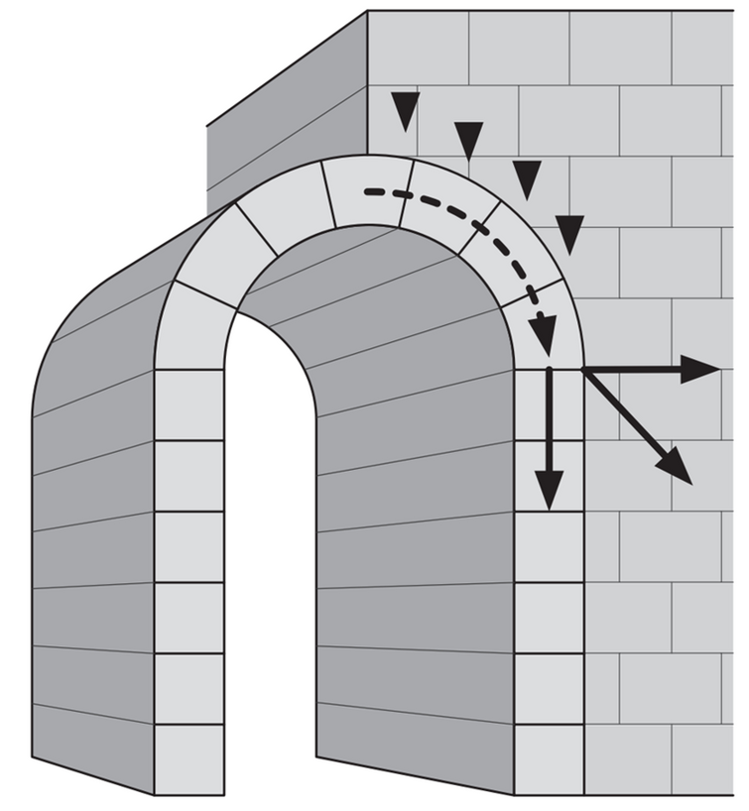
Architecture and Engineering
The Romans were great engineers and builders. Many of their innovations and techniques have been used in building ever since.
Rome was the first European civilisation to invest in large-scale public works. The Romans built long-lasting roads that helped to increase trade and also helped their armies to move rapidly about the empire. Many modern roads are built along the same routes as these roads. They built aqueducts to carry fresh water into towns and cities.
The Romans invented concrete to make their buildings more durable. They used rounded arches and pillars to hold up large ceilings and built huge domes on their temples. Many Roman buildings were so well constructed that they are still standing today, like the Pantheon in Rome. Their techniques were copied in the Renaissance and still influence modern architecture.
Strand Three: The History of Europe and the Wider World
Chapter Four: Ancient Rome
Diagram taken from Artefact, 2nd Edition by Eimear Jenkinson and Gregg O'Neill (educate.ie)
@MsDoorley

Slide 51
Christianity
Language
Calendar
The Roman Empire's conversion to Christianity meant that the Catholic Church became the world's most powerful religion in the following centuries. Even after the Western Roman Empire fell in the fifth century AD, the Catholic Church acted as a unifying force in Western Europe.
Latin was the language of the Roman Empire. It is not spoken today but many modern European languages (French, Spanish, Portuguese, Italian and Romanian) are based on it. English is not related (it is a Germanic language) but almost one-quarter of English words are directly influenced by Latin.
In 45 BC, Julius Caesar introduced a new calendar to replace the old Roman one, which was too inaccurate. His new Julian calendar had 365 days divided into 12 months and an extra day every four years. It was changed slightly by Pope Gregory XIII in 1582 and called the Gregorian calendar, but remains the basis for the calendar we use today.
Strand Three: The History of Europe and the Wider World
Chapter Four: Ancient Rome
@MsDoorley

Slide 52
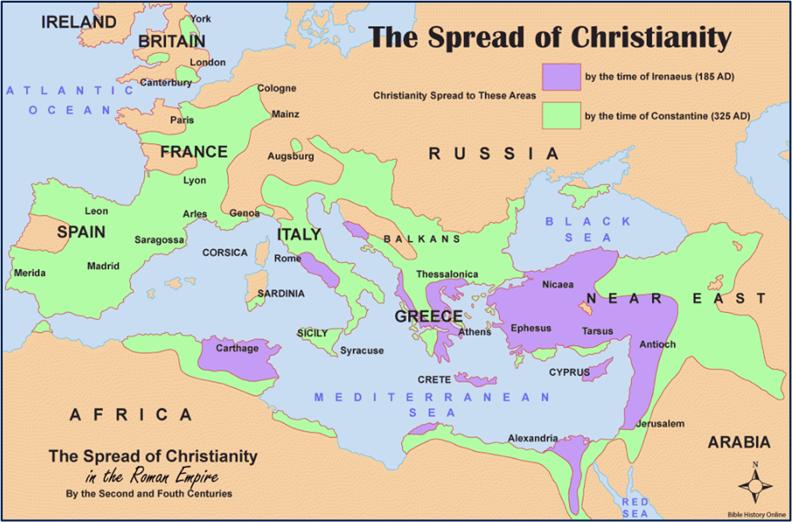
Strand Three: The History of Europe and the Wider World
Chapter Four: Ancient Rome
@MsDoorley

Slide 53
Checkpoint (Pg. 33, Artefact 2nd Edition)
  Which Roman inventions helped the development of architecture?
  How did the Romans help the spread of Christianity?
  Which modern languages are descended from Latin?
  What changes did Julius Caesar make to the calendar?
Strand Three: The History of Europe and the Wider World
Chapter Four: Ancient Rome
@MsDoorley

Slide 54
Checkpoint (Pg. 33, Artefact 2nd Edition)
  Concrete; rounded arches and pillars to hold up large ceilings.
  Christianity became the official religion of the Roman Empire. Gradually, the huge empire became predominantly Christian, making Christianity the most powerful world religion over the following centuries.
  French, Italian, Spanish, Portuguese, Romanian.
  Julius Caesar introduced the 365-day, 12-month calendar that we still use today.
Strand Three: The History of Europe and the Wider World
Chapter Four: Ancient Rome
@MsDoorley

Slide 55
1A Geography
  Complete pages 6-9 in skills book.
  Finish the worksheet from class Wednesday on mt st Helens
  study for test on Monday
Strand Three: The History of Europe and the Wider World
Chapter Four: Ancient Rome
@MsDoorley

Slide 56
735 BC to AD 476
Chapter 4
4.6: SUMMARY
4.6: summary
Strand Three: The History of Europe and the Wider World
@MsDoorley

Slide 57
In this chapter, we have learned that...
Rome rose from a cluster of small villages on the Tiber to control the entire Mediterranean world and most of Western Europe. It was the most powerful empire in the ancient world.
Roman society was divided up into patricians and plebeians. The patricians were the wealthy elite who ran the empire, lived in a domus and had many slaves. Their sons were well educated and their daughters were married into other patrician families.
The plebeians were the vast majority of the population. They were poorer, lived in insulae apartment blocks and worked for a living as a craftsmen and soldiers.
All Romans enjoyed a vast selection of public entertainments: public baths, chariot racing, theatre and gladiator fights. Gladiators were slaves who fought in amphitheatres.
The Roman army was the most successful fighting force in the ancient world. Men signed up for 25 years of service and were highly trained. They fought with a vast array of weapons and could march long distances in a short time.
The Romans worshipped many different gods and goddesses. Their religion dominated every aspect of their lives. They offered sacrifices to the gods and held elaborate funerals. Christianity was initially persecuted by the Roman Empire but became the official religion of the empire in the late fourth century.
Rome’s legacy has lived on in European civilisation and beyond through architecture, Christianity, language, the calendar and more.
Strand Three: The History of Europe and the Wider World
Chapter Four: Ancient Rome
@MsDoorley

Slide 58
Reflecting on... Ancient Rome
A foundation stone of Western society, Rome's achievements in engineering, warfare and culture are impressive to this day. The story of the growth and ultimate fall of Rome is often used to examine problems in modern society. However, me must remember its success was built on conquest and slavery - it is an excellent example of the importance of seeing history 'warts and all'.
Strand Three: The History of Europe and the Wider World
Chapter Four: Ancient Rome
@MsDoorley

Slide 59
Examination Questions
2023 SEC Q1e, Q1f
Strand Three: The History of Europe and the Wider World
Chapter Four: Ancient Rome
@MsDoorley

Slide 60
Exploring History pg. 64 (Artefact, 1st Edition)
2023 SEC Q1e, Q1f
Strand Three: The History of Europe and the Wider World
Chapter Four: Ancient Rome
@MsDoorley

Slide 61
Project
Guidelines:
  Length: The depth of your project should reflect about 2-3 weeks of work.
  Sources: Use at least three different sources for your research. These can be books, scholarly articles, or reputable online resources.
  Citations: All information and images that are not your own should be properly cited.
  Mediums: You may choose to present your project in one of the following ways:
    Poster: Your poster should be informative and visually engaging.
    Minecraft or Lego Model: If choosing this option, please also include a brief report explaining your model.
    Painting/Drawing: Your artwork should be accompanied by a description.
    Recycled Materials: Create your model using recycled materials and provide an explanation of your creative process.
Assessment:
Your projects will be assessed based on:
  Research and Content
  Creativity and Presentation
  Understanding of Context
  Adherence to Guidelines
Strand Three: The History of Europe and the Wider World
Chapter Four: Ancient Rome
@MsDoorley

Slide 62
Project
Historical Sites
Historical Figures
The Colosseum, Rome
Pompeii, Italy
Forum Romanum, Rome
Hadrian's Wall, England
Ostia Antica, Italy
Julius Caesar
Spartacus
Trajan
Augustus
Cicero
Lucilla
Livia Drusilla
Virgil
Hannibal
Nero
Constantine
Helena
Strand Three: The History of Europe and the Wider World
Chapter Four: Ancient Rome
@MsDoorley

